Slide 1
EMIS Special Education
Reports

Slide 2
Reports
EMIS Federal Child Count Reports
  2017s_stu_fed_child.csv – detail report
  2017s_stu_fed_child.pdf – summary report
Data Collector
  FTE Detail
  FTE Adjustment

Slide 3
The Federal Child Count Reporting

Slide 4
Overview
The Federal Child Count (FCC)
  Includes students with disabilities who are receiving special education and related services according to their IEPs as of October 31
  Is used in determining the amount of Special Education Part-B IDEA and Early Childhood Special Education funds allocated to the state
  Is collected from traditional school districts, community schools and STEM districts through the Education Management Information System (EMIS) and is submitted to the US Department of Education (USDOE)
Notes:
ESC’s and JVSD’s do not receive a Federal Child Count Report. FY17 Federal Child Count reports are currently being generated.

Slide 5
EMIS Data Collections and the FCC Snapshot
There are four collections used to submit FCC Data
  Beginning of Year Student (S) Collection
  Midyear Student (S) Collection
  SOES Beginning of Year Student (S) Collection
  SOES End of Year Student (S) Collection
FCC Snapshot date to be determined and communicated in an EMIS Newsflash
Notes:
Presenter can demonstrate where to find these collections in the Data Collector

Slide 6
Federal Child Count
CSV Detail Report

Slide 7
No SSID/LEA Match
When the EMIS ID is blank and the Name column contains “No SSID/LEA Match”, this could be because the process to add the name and EMIS ID onto the report did not work
This is not an indication of an error; look up the student using the SSID
Notes:
ITC Staff - If there are a large number of No SSID/LEA Match messages, verify that the process to load names is working properly. Consider using the VLOOKUP process from the Basic Excel training.

Slide 8
Least Restrictive Environment (LRE) Source Codes
Column header title - DIST_LRE_SOURCE_CODE
The District LRE Source Code
  indicates where the LRE is pulling from for that student or
  that an LRE cannot be found
Source Codes indicating an issue that will exclude the student from the count
  Source Code 1 = No Disability on October 31
  Source Code 3 = Student’s age is not 3 – 21
  Source Code 5 = No IEP Reported (Uses IENS “IEP outcome not served” as LRE)

Slide 9
LRE Source Code, cont’d
Source codes indicating the LRE used in the count
  Source Code 7 = Using the FN270 Override
  Source Code 8 = Using the GE Record
  Source Code 9 = How Received = 6 (Uses IE39 regardless of LRE reported)
  Source Code A = Sent Reason = AU or JP (Uses IE39 as LRE)
Notes:
Presenter explain where the FN270 element and the GE Record are located in the student information system (SIS) Recommend that attendees refer to the EMIS Manual for guidance as to valid FN270 and GE Record LRE options.

Slide 10
USDOE Child Count Flag
USDOE_CHILD_COUNT_FLAG values
  Y – Student included in the Federal Child Count
  N – Student not included in the Federal Child Count
  In some cases, the flag can be set to “Y” but the student is still excluded
    LRE = IENS, for example
Notes:
Presenter demonstrate filtering on the USDOE_CHILD_COUNT_FLAG

Slide 11
Additional Information
DIST_LRE_SOURCE_DESCR
  “Student Age not 3-21” and then view the values for these students in the AGE column. Verify the student’s date of birth
AGE
  View students age 3-5 and look for a preschool LRE in either the SPECED_OUTCM_CODE or UPDATE_OCT_31_IEP_OUTCM_CODE columns
  View students age 6-21 and look for a school age LRE in either the SPECED_OUTCM_CODE or UPDATE_OCT_31_IEP_OUTCM_CODE columns
DISAB_CNDTN_CODE
  Verify that disability codes have been entered correctly
Notes:
Presenter demonstrate each of these suggested filters

Slide 12
Status Code Column
Indicates the status of a student as it relates to inclusion in the count
Indicates that a data issue exists or that no errors are detected
Data with no errors on the report should still be reviewed for accuracy
Notes:
Presenter- Mention again that references to ”DCC” on the report are from the previous name “December Child Count”

Slide 13
Status Code A
DCC_Status_Code = A
  Oct 31 FD does not show a disability
  View the student’s disability condition element on the Student Attributes - Effective Date (FD) Record and verify that the disability condition is being reported correctly as of October 31
  If the student’s FD Record start date is incorrect, make the correction and submit updated EMIS data
Notes:
Presenter can demonstrate filtering and also show where this data can be found in the student information system

Slide 14
Status Code C
DCC_Status_Code = C
  Most recent IEP shows exit outcome
  Verify outcome of the most recent Evaluation Team Report (ETR)
  If the student exited special education, the student’s disability code should be reported with an end date of the exit ETR event
Notes:
Presenter can demonstrate filtering and also show where this data can be found in the student information system

Slide 15
Status Code D
DCC_Status_Code = D
  Age is outside 3 to 21
  View the student’s reported date of birth on the Student Demographic (GI) Record to confirm age
  If the student’s date of birth is incorrect, make the correction and submit updated EMIS data
Notes:
Presenter can demonstrate filtering and also show where this data can be found in the student information system
Note that if a data of birth is changed, SSID/IBM data would also need to be corrected

Slide 16
Status Code G
DCC_Status_Code = G
  Unable to translate LRE-must report FN270
  The FCC uses age to determine the USDOE LRE Code
  As of October 31 the student’s IEP Outcome (LRE) must agree with the student’s age
    Students 3 through 5 = preschool LRE
    Students 6 through 21 = school-aged LRE
Notes:
Presenter can demonstrate filtering and also show where this data can be found in the student information system
A student ages 3 through 5 must have a preschool LRE. If student age 5 has a school aged LRE, report an FN270 with a preschool LRE
A student ages 6 through 21 must have a school aged LRE. If student age 6 has a preschool LRE, report an FN270 with a school age LRE

Slide 17
Status Code P
DCC_Status_Code = P
  Most recent IEP is CIEP should be no disability
  Verify the CIEP event and confirm that the student’s disability code is being reported with the end date of the CIEP event
  If the student’s disability code on the Student Attributes - Effective Date (FD) Record does not have an end date, make the correction and submit updated EMIS data
Notes:
Presenter can demonstrate filtering and also show where this data can be found in the student information system

Slide 18
Status Code R
DCC_Status_Code = R
  No LRE reported – assigned no services LRE
  Verify the student’s special education event records as of October 31
  Is there an IEP event that needs to be entered?
  If there is no IEP reported, does the situation qualify for an NIEP event to be reported?
  If the student’s special education record is incorrect, make the correction and submit updated EMIS data
Notes:
Presenter can demonstrate filtering and also show where this data can be found in the student information system. Note that additional information about reporting an NIEP is on the next slide.

Slide 19
Explanation of NIEP Date Type - No IEP
NIEP is reported when services are being provided without an active IEP
NIEP cannot be used prior to an Initial IEP being in place
NIEP events can only be reported in specific situations
  Student newly transferred in; IEP adoption determination not complete; services being provided based on prior IEP
  IEP expired; new IEP not in place; services being provided based on prior IEP
  IEP current, but not reported to EMIS in prior collection; services provided based on current IEP
Refer to the EMIS Manual Section 2.13 Student Special Education (GE) Record for additional information
Notes:
Demonstrate adding an NIEP event in the source system if applicable.

Slide 20
Status Code S
DCC_Status_Code = S
  Does not meet inclusion filter in this district
  Review Student Standing (FS) coding
  Refer to the Federal Child Count Report Explanation, section “Include in USDOE Count”
  Open enrolled in and court placed in students often have this status at the educating district
Notes:
Presenter can demonstrate filtering and also show where this data can be found in the student information system
Refer to the Federal Child Count Report Explanation for inclusion business rules.

Slide 21
Students Reported by Multiple Districts
1. Student counts where Reporting IRN = District of Residence IRN
~OR~ counts where Reporting IRN is reporting a How Received code of M (Community School) or K (STEM District)
2. If entities are claiming the student in the same way (as above), then the student is included at the entity with the later Admission Date
3. If entities are claiming the student in the same way as in number 1 and reporting the student with the same admission date, then the student will not count for any district
Notes:
The next two slides will reference these tiebreakers used in the inclusion criteria of the Federal Child Count reports.

Slide 22
Status Code T
DCC_Status_Code = T
  Student in ###### (IRN) - does not count in your district
  Student counts at the IRN in the status code message
  Review data in ODDEX to compare how data is being reported
  Communicate with the district in the Status Code Message to determine how this student should be reported
Notes:
Presenter- This is an example of Tiebreaker #2
Demonstrate filtering and also show where this data can be found in the student information system.
Depending on a student’s individual situation, use SOES, SCR or History modules of ODDEX to determine the data reporting issue.

Slide 23
Status Code U
DCC_Status_Code = U
  Student excluded – conflict in where they should count
  Could not determine where this student should count and the student will not be counted anywhere
  Review data in ODDEX to compare how data is being reported
  Communicate with the district in the Status Code Message to determine how this student should be reported
Notes:
Presenter – This is an example of Tiebreaker #3
Demonstrate filtering and also demonstrate where this data can be found in the student information system
Depending on a student’s individual situation, use SOES, SCR or History modules of ODDEX to determine the data reporting issue.

Slide 24
Status Code V
DCC_Status_Code = V
  No errors identified in ODE processing
  Data for the students should still be reviewed for accuracy
  Apply filters to verify elements such as disability conditions and LREs
  District staff can be very helpful in verifying data accuracy and completeness
Notes:
District staff who work with the students can sometimes find data issues even when no errors are generated, such as an incorrect disability condition.

Slide 25
Federal_Child Count
PDF Summary Report

Slide 26
Federal Child Count Summary Report
The STU_FED_CHILD.PDF report is 15 pages long
Page 1 – Students with disabilities age 3 to 5 as of October 31
Page 2 through 14 – Students reported by disability condition, ages 6 to 21 sorted by LRE Option
Page 15 – Statement of Assurance
Review this report after verifying the CSV Detail Report
Notes:
Remind attendees to use the most recent version of the summary report and if matching it to the detail report, use the same version.
Explain that if the student is not appearing correctly on the Detail Report they will also appear incorrectly on this report.

Slide 27
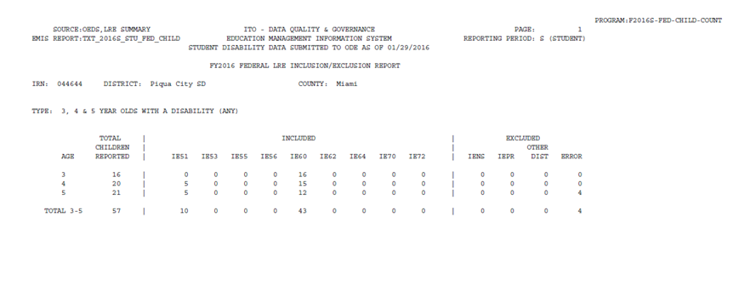
Summary Report – Specific Categories
First Filter = AGE is 3,4,5
Second Filter = USDOE_LEAST_
RSTRCT_ENVMNT_CO is IE51
Notes:
This is the first page of the Federal Child Count Summary Report We are going to identify the students who are ages 3, 4 or 5 and have an LRE of IE51 on the Detail Report PRESENTER- For the next six slides, use the slides to demonstrate.

Slide 28
Detail Report – Specific Categories
Second Filter = USDOE_CHILD_COUNT_FLAG is IE51
First Filter = AGE is 3,4,5
Notes:
This shows 10 students between the ages of 3 and 5 who have a USDOE LRE of IE51. These students are all counting at this reporting entity (USDOE_CHILD_COUNT_FLAG = Y) and the DCC_STATUS_CODE is V “No errors identified in ODE processing”.

Slide 29
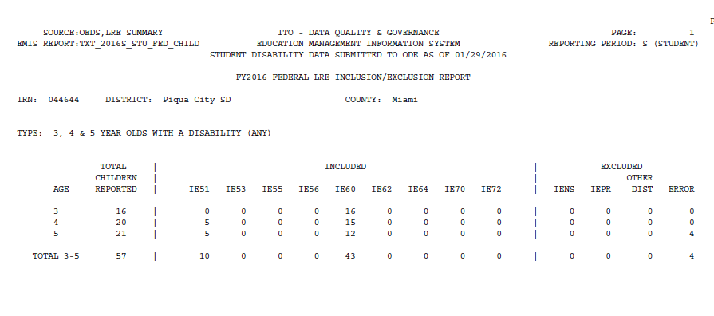
Summary Report - Students with Errors
First filter = AGE is 3,4,5
Second filter = USDOE_LEAST_RSTRCT
_ENVMNT_CO is BLANK
Notes:
In this example, we are going to identify which students are appearing in the “error” column. We first filter on ages 3, 4 and 5 and then filter on the USDOE_LEAST_RSTRCT_ENVMNT_CO is blank. This will show us names of students with errors.

Slide 30
Detail Report – Students with Errors
First filter = AGE is 3,4,5
Second filter = USDOE_LEAST_RSTRCT_ENVMNT_CO is BLANK
Notes:
In this example the report cannot determine the LRE and is stating “Unable to translate LRE- must report FN270”

Slide 31
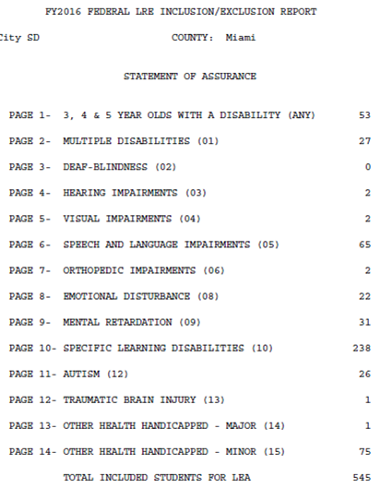
Summary Report - Statement of Assurance
To match the Statement of
Assurance with the CSV file,
apply the following filters:
Filter 1 = USDOE_CHILD_COUNT
_FLAG is Y
Filter 2 = DIST_LEAST_RSTRCT_
ENVMNT _CODE is NOT IENS
Filter 3 = DISAB_CNDTN_CODE
by each value
Notes:
The Statement of Assurance is all students who are included in the FCC for this school. The is often requested by Auditors.

Slide 32
Detail Report - Statement of Assurance
Filter 1 = USDOE_CHILD_COUNT_FLAG is Y
Filter 2 = DIST_LEAST_RSTRCT_ENVMNT_CODE is NOT IENS
Filter 3 = DISAB_CNDTN_CODE by each value
Filter 2
Filter 1
Filter 3
Notes:
Filter by each disability condition to see the students who make up each count on the Statement of Assurance.

Slide 33
Resources
Federal Child Count Report Explanation
  ODE Home > Data > EMIS > Documentation > EMIS Validation and Report Explanations
EMIS Manual
  ODE Home > Data > EMIS > Documentation > EMIS Manual
Your district staff
Your ITC

Slide 34
Data Collector
Level 2 Reports
FTE Detail and FTE Adjustment

Slide 35
Funding Reports
There are a number of FTE Funding reports available
  FTE Detail Report
    Can be used to reconcile the payment reports received by districts. It is useful to treasurers and other district administrators as well as the district EMIS coordinator.
  FTE Adjustment Report
    Students whose FTE’s are adjusted and why
    FT0005 – Disability Not Funded
Notes:
Presenter - use FCC_2017s_stu_fed_child.csv to demonstrate

Slide 36
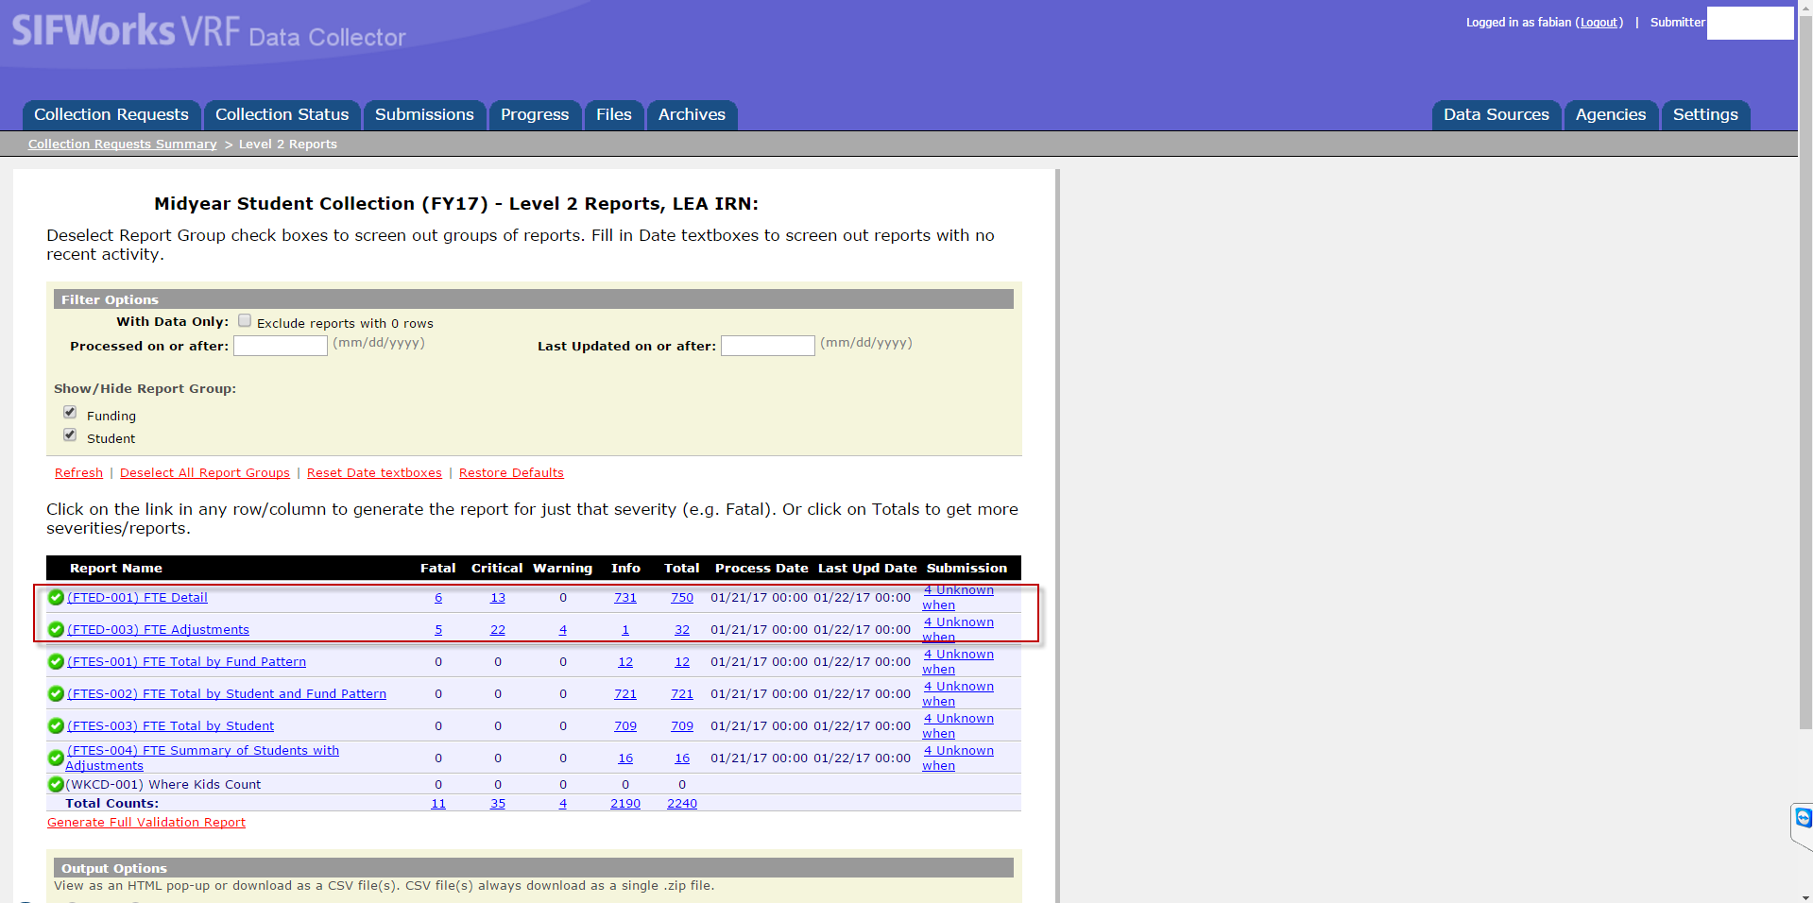

Slide 37
FTE Detail

Slide 38
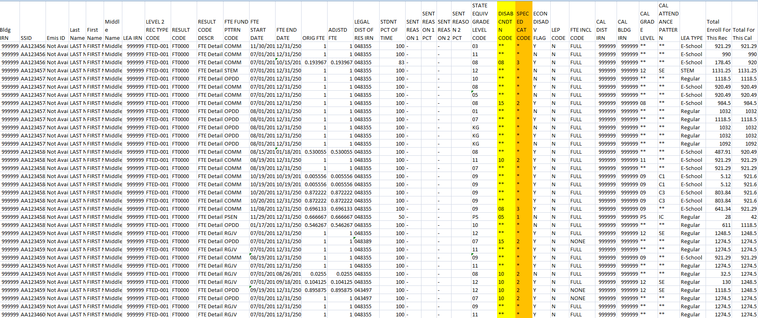

Slide 39
FTE Adjustments

Slide 40
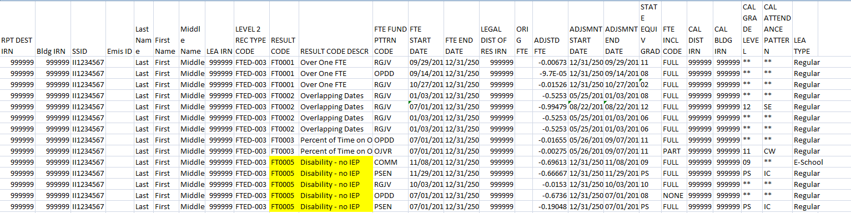

Slide 41
Questions?
Notes:
Presenter- Insert your contact information on this slide.

